Slide 1

Islamic University Of Science & Technology
Library
Management
System
Group P
Presented by :-
Pir Hilal Ahmad (MCA-21-25)
Zameer Ahmad Mir(MCA-21-61)

Slide 2

Contents
1.Introduction
2.Existing System
3.Proposed System
4.Objectives
5.Modules
6.Future Scope
7.Conclusion

Slide 3

Introduction
A Library Management System is a project that tries to create an automated and computerised version for a library so that the daily work of a library can be managed and monitored easily and efficiently.

Slide 4

Existing System
The existing system here is the "traditional library' which we use to see from the times before. The existing system here is completely manual run system. The burden of controlling the library entirely lies in the shoulder of the admin. More over the term "user friendly" doesn't have a place to stand in the existing library system, as the user have the heavy work of finding a desired book from the library. Some of the major drawbacks the existing system faces is includes, wastage of time, man power, inconsistency, absence of secure mechanism, burden of record keeping & wastage of storage space, expensive.

Slide 5
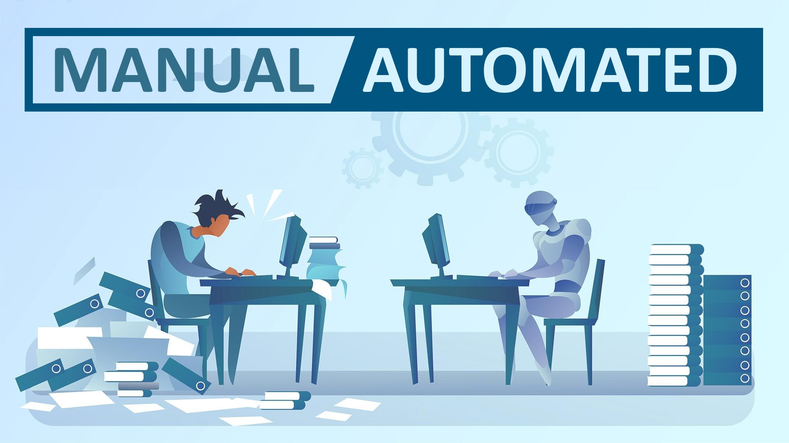
Proposed System

Slide 6

Objectives
Automation and Efficiency
User-Friendly Interface
Real-Time Information
Accurate Tracking and Reporting
Fine Management
Renewal System
Data Security

Slide 7
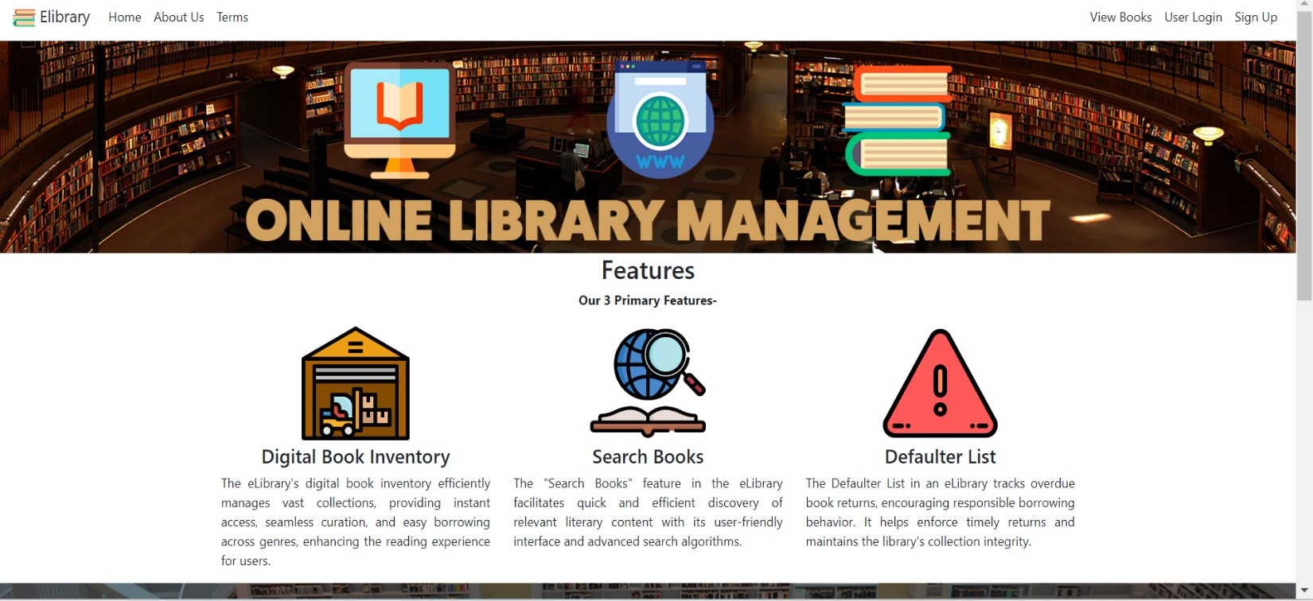
Modules
HOMEPAGE:
User SignUp
User Login
Admin Login
Anonymous User

Slide 8
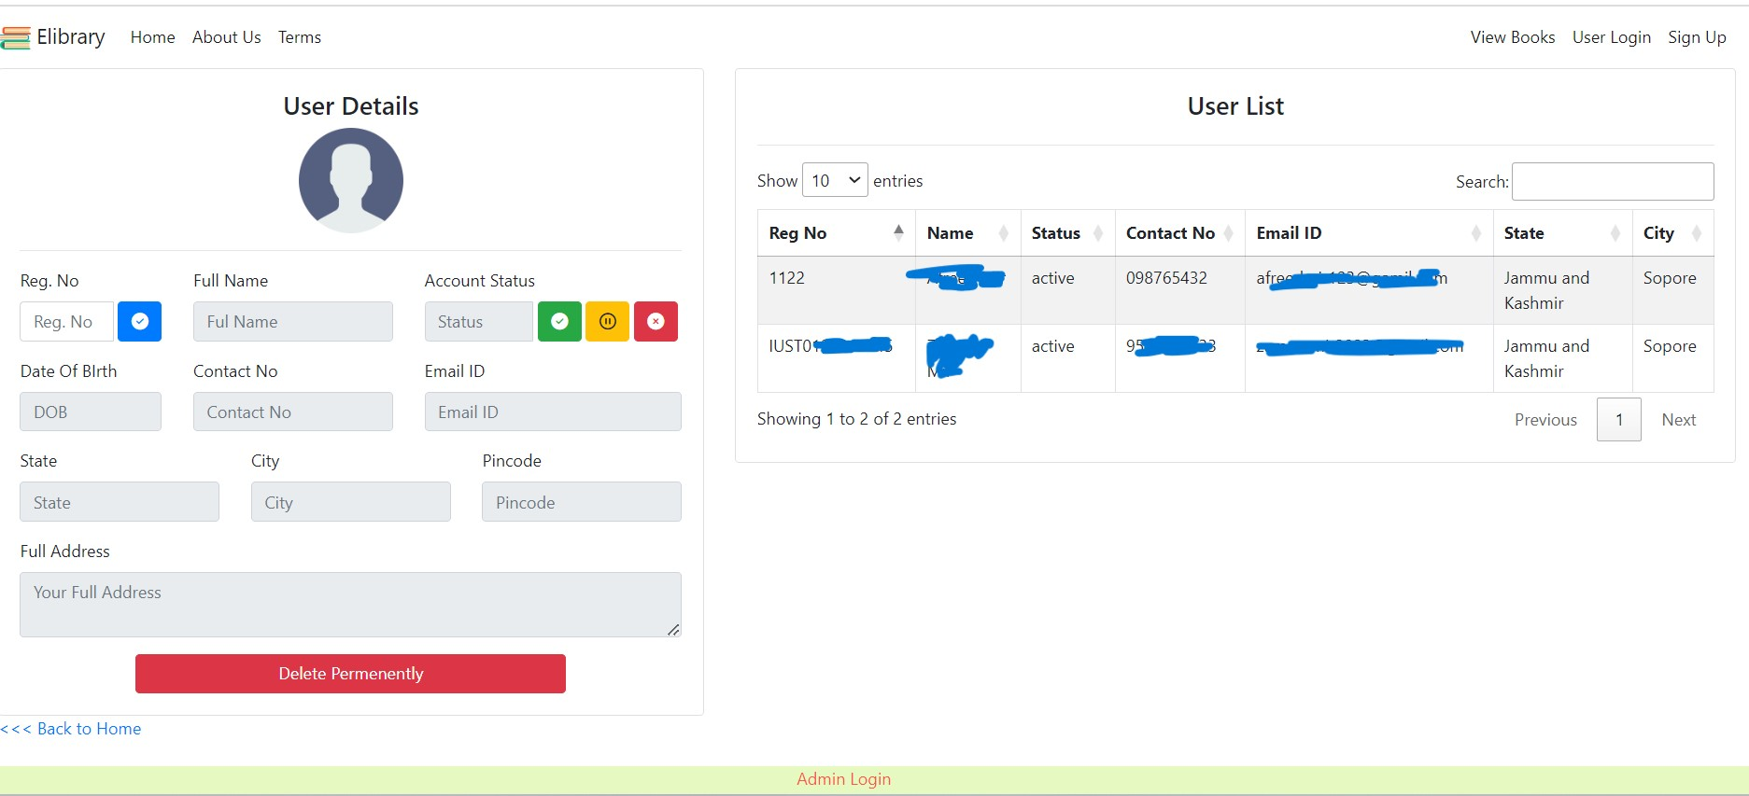
Contd…
ADMIN MODULES:
Author Management
Publisher Mangement
Book Inventory
Book Issuing
Book Return
Book Renewal
Member Management
Fine Management

Slide 9
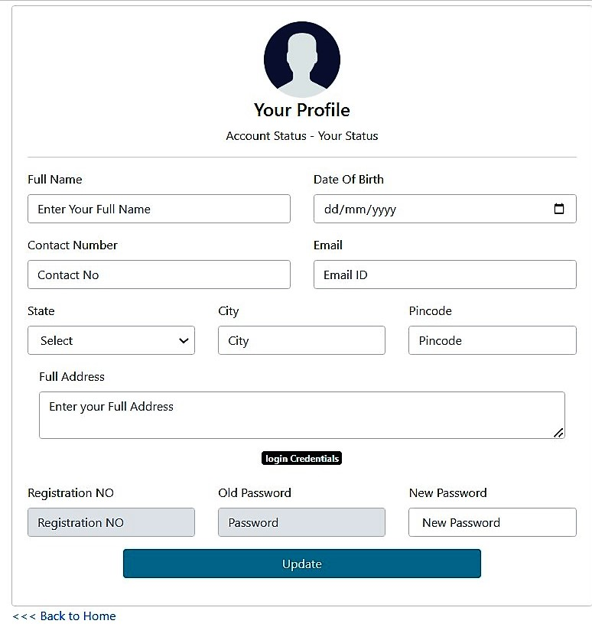
Contd…
User Modules:
View Profile
Update Profile
View Books
Check Due-date
Check Fine

Slide 10
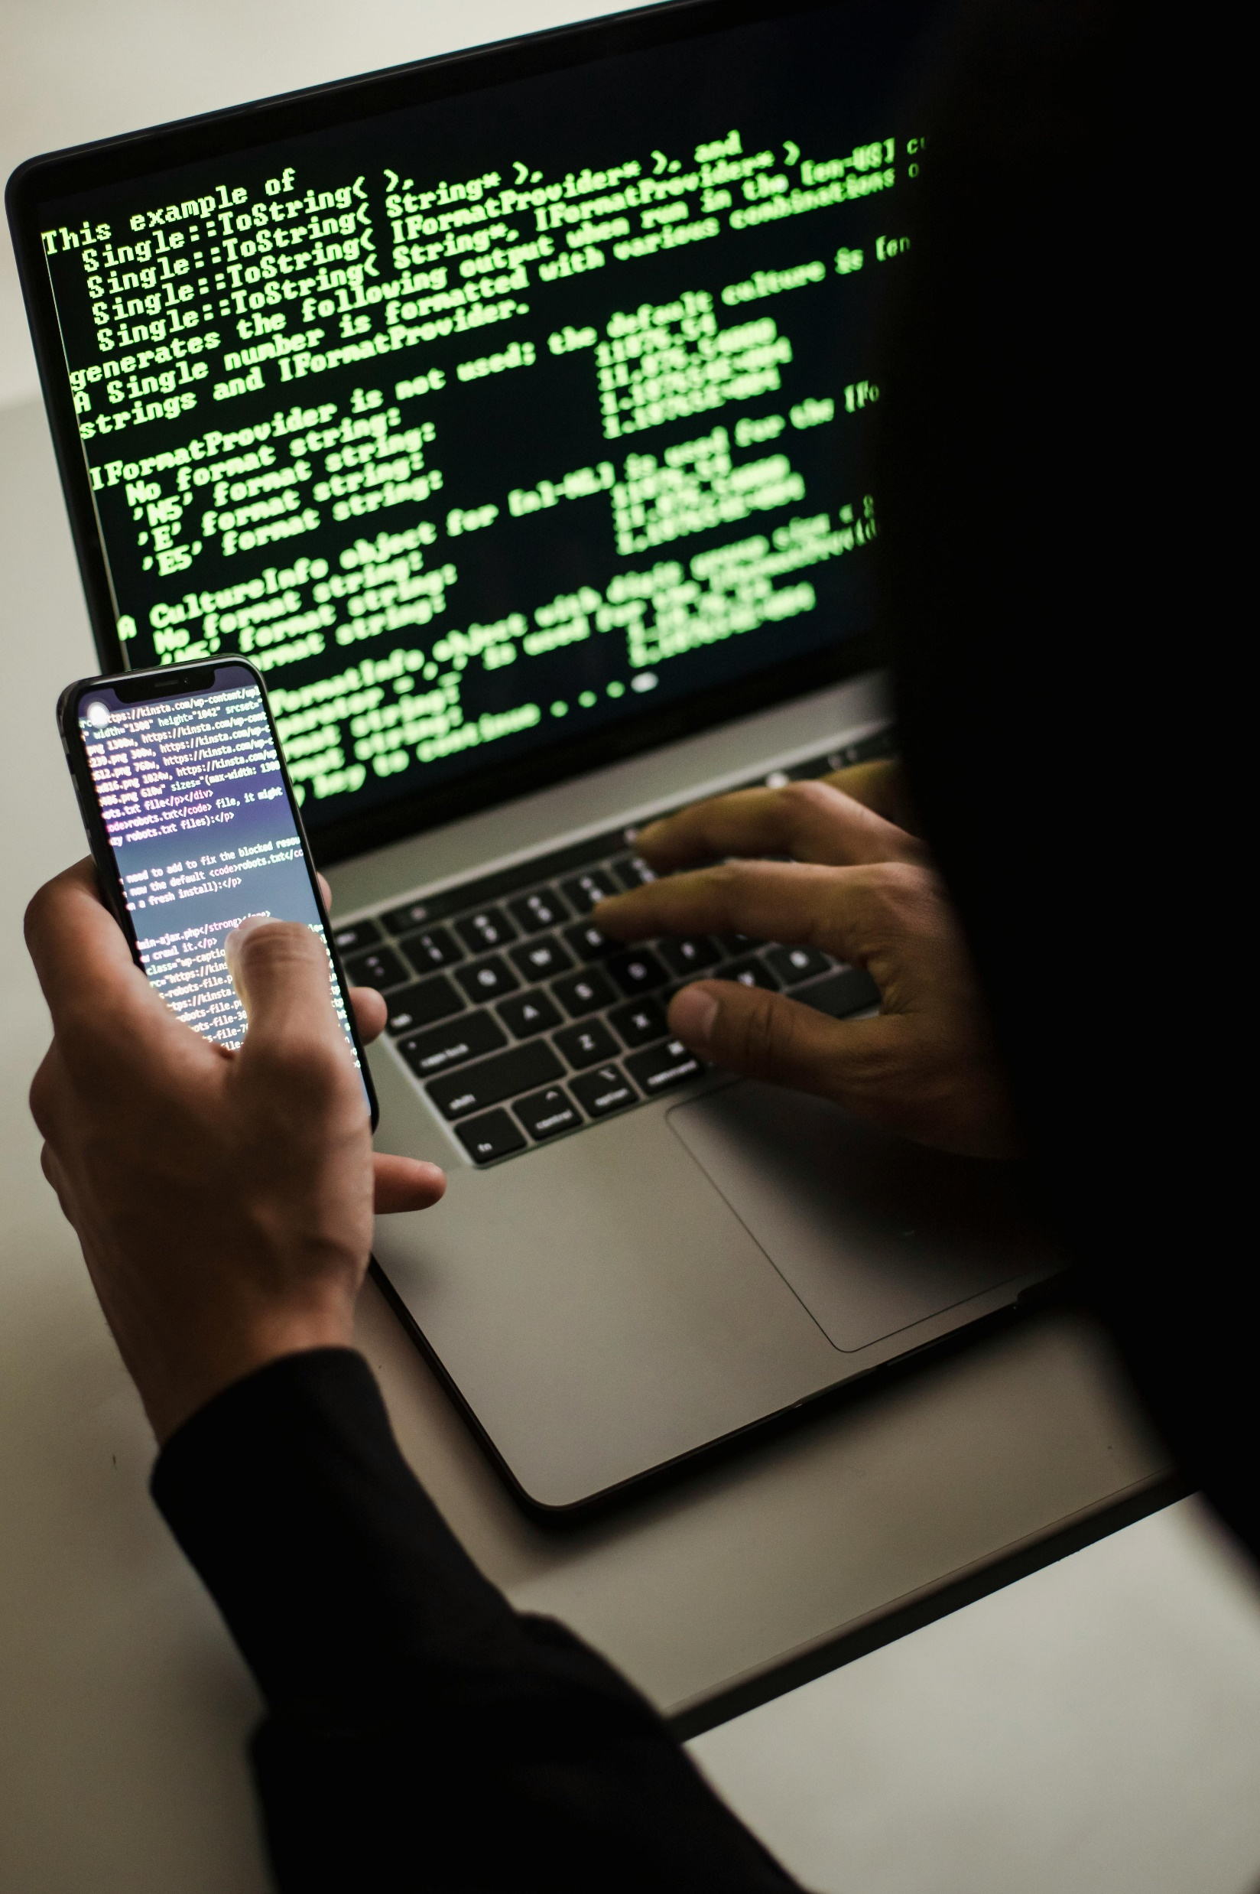
Future Scope
Artificial Intelligence Integration
Enhanced User Analytics
AI-Driven Personalization
To Implement email and SMS technology into the system

Slide 11

Conclusion
This website provides a computerized version of library management system which will benefit the students as well as the staff of the library.
The implementation of the system in the organization will considerably reduce data entry time and also provide readily calculated reports.

Slide 12

☺ Thank You: We extend our heartfelt gratitude for your time and attention.

